Slide 1
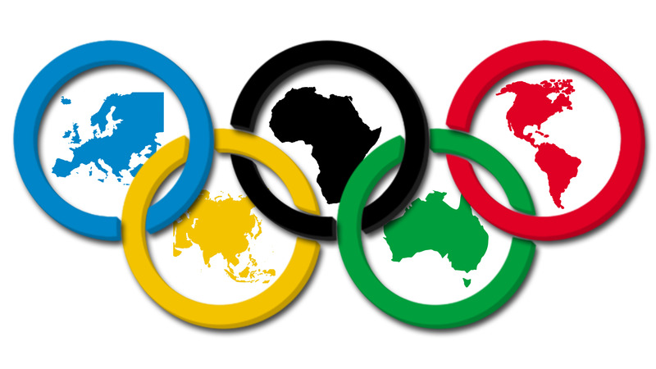
OLYMPIC DREAMS
An analysis of the physical and mental characteristics of Olympic athletes and their effects on success

Slide 2
THE QUALITIES OF AN OLYMPIC ATHLETE
Can anyone who meets the physical profile of an Olympic athlete achieve his/her Olympic dreams?
What other attributes could play a role in the success of an athlete?
Does mental health have an effect on athletes – positive or negative, significant enough to eclipse all other qualities that may lead success?

Slide 3
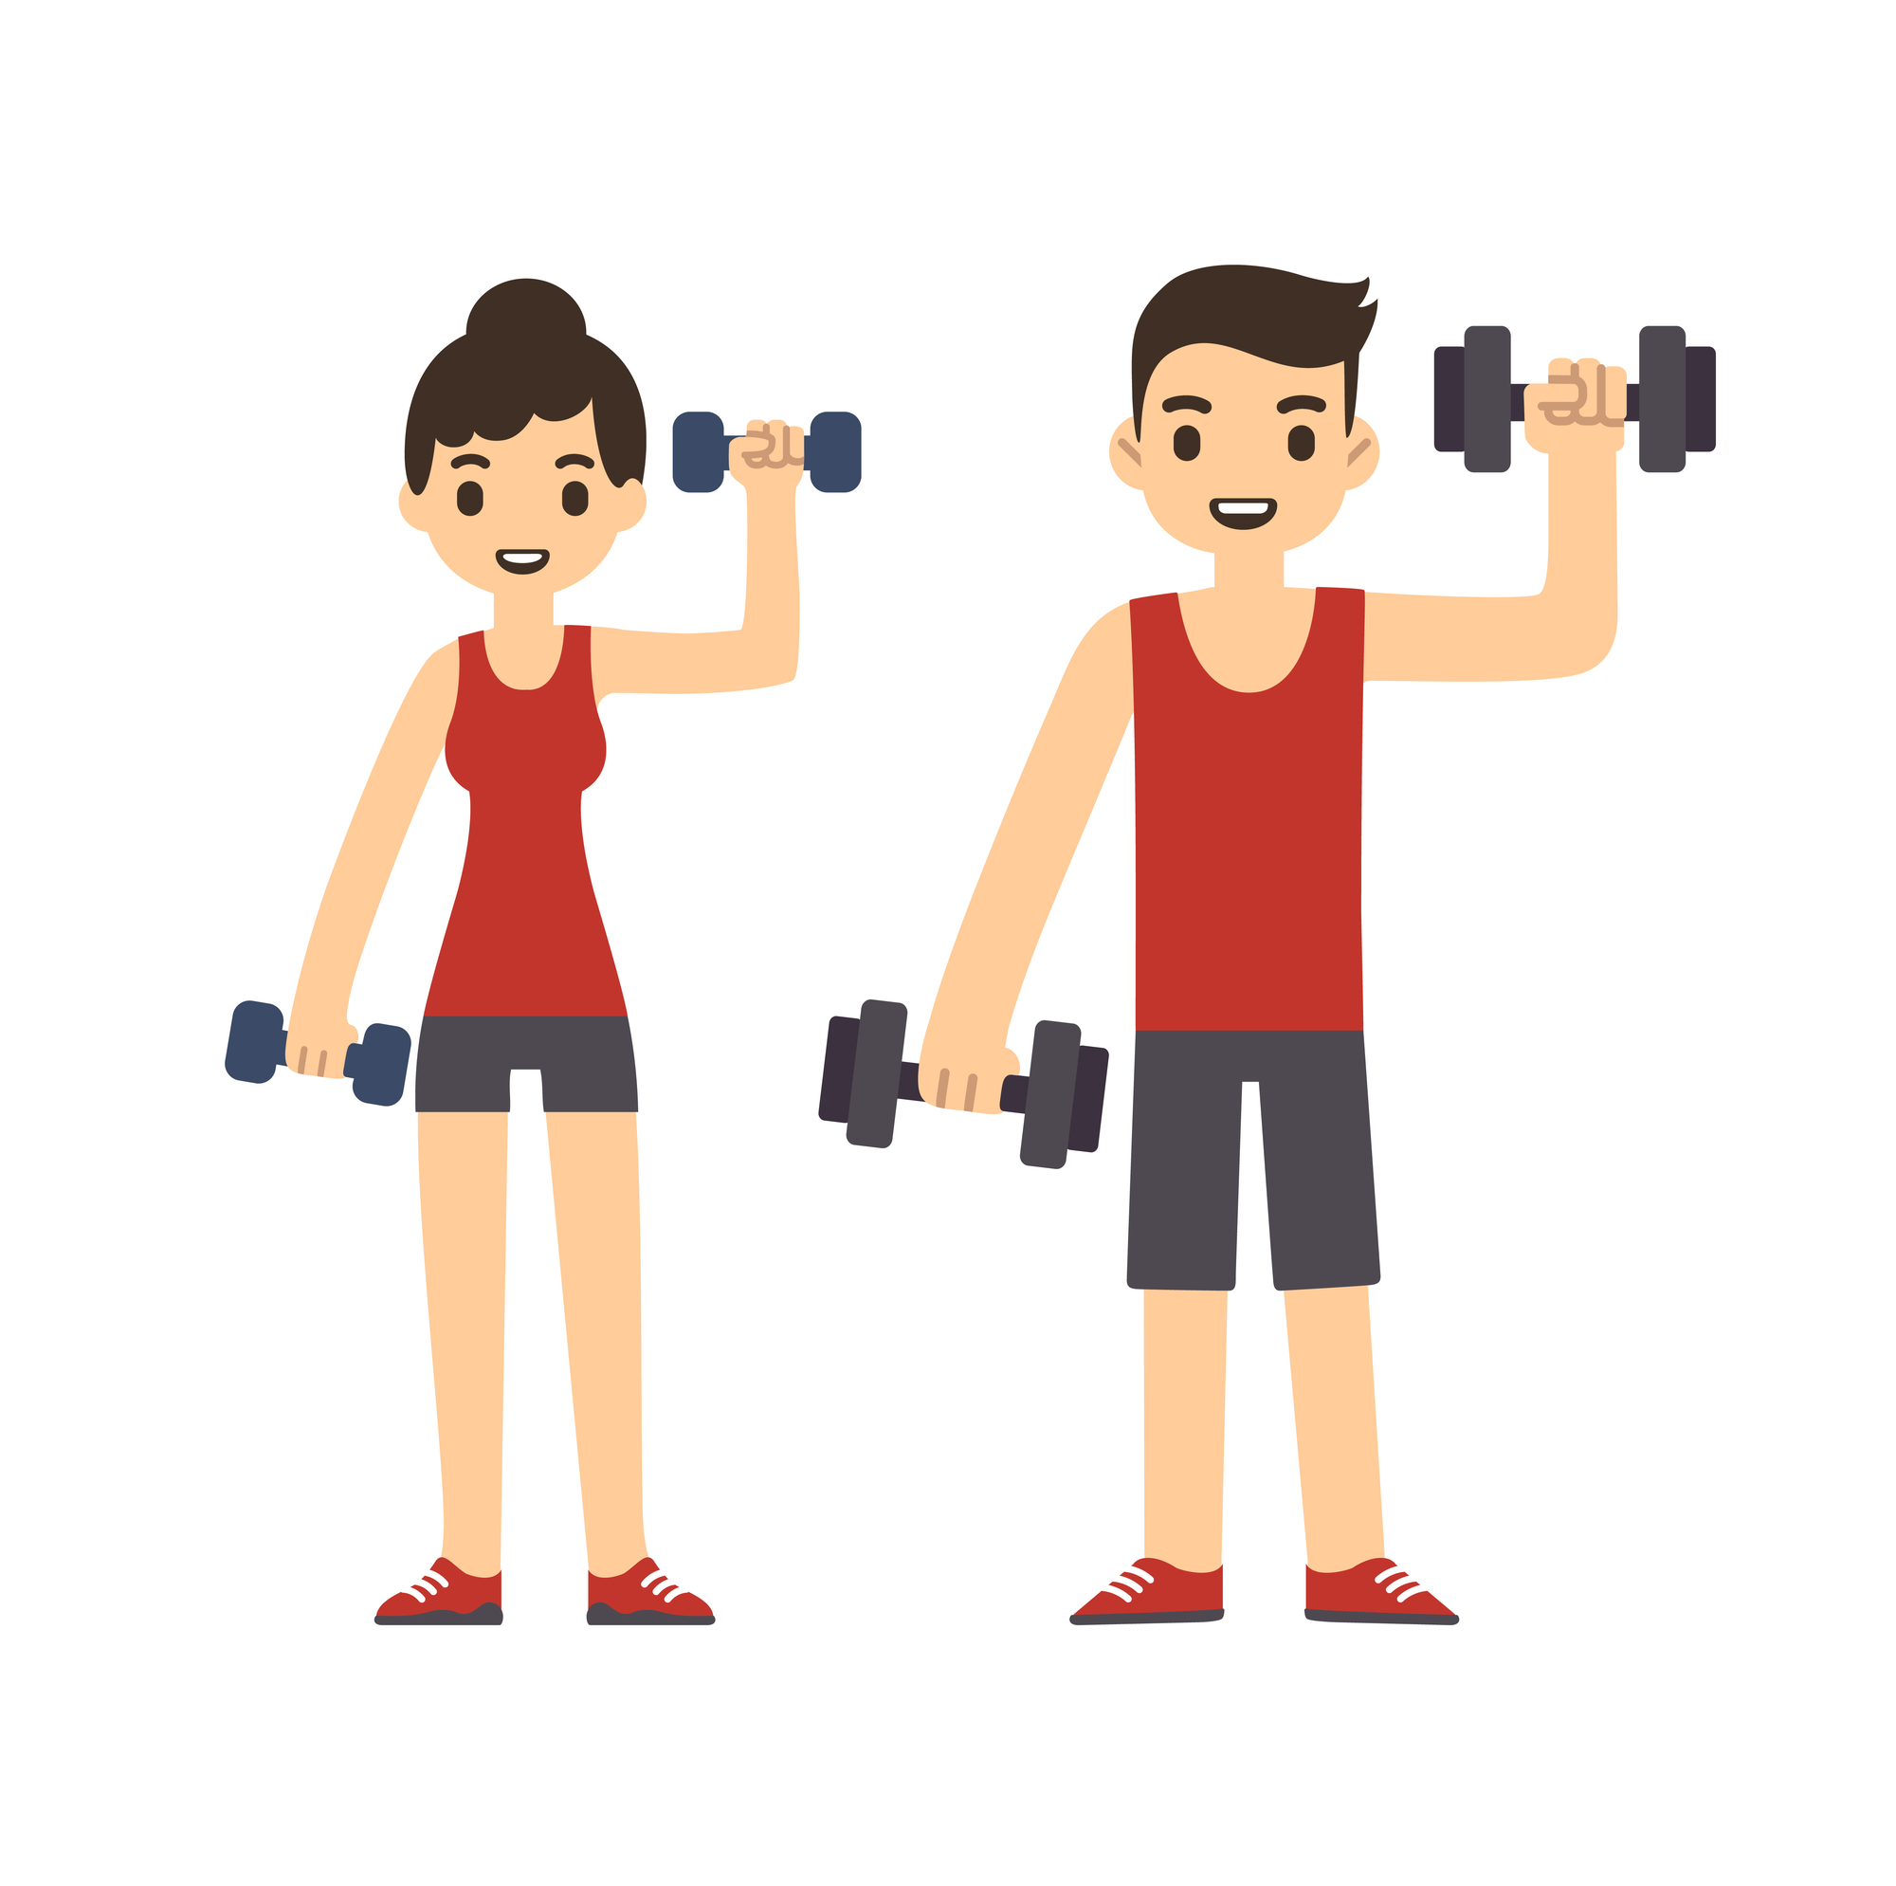
OLYMPIC HOPEFULS
JANE
Sex: Female
Age: 22
Height: 154 cm
Weight: 47 kg
Nationality: USA
BOB
Sex: Male
Age: 28
Height: 193 cm
Weight: 95 kg
Nationality: AUS

Slide 4
DATASET FOR ANALYSIS
Kaggle Dataset “120 Years of Olympic History”
Data cleaning processes:
Identify nuances in Team and/or NOC data – make “same” data same
Drop all null values in fields that will be used for analysis – Height, Weight, Age
Delete duplicate athletes for the purpose of some analysis (maintained for medal counts)

Slide 5
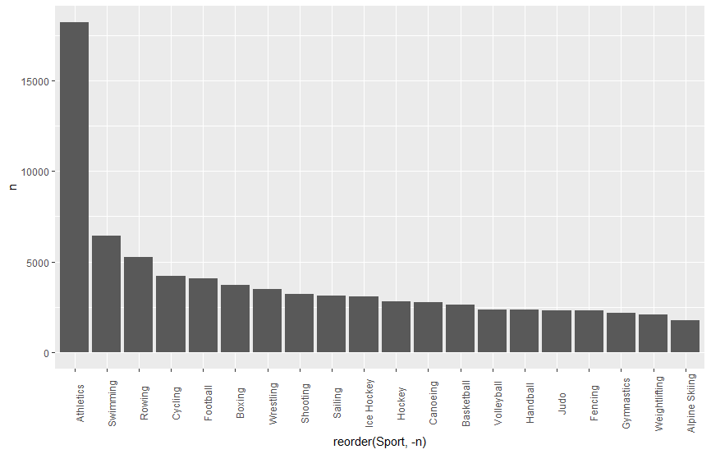
UNDERSTANDING THE DATA
Datapoint Count per Sports Category

Slide 6
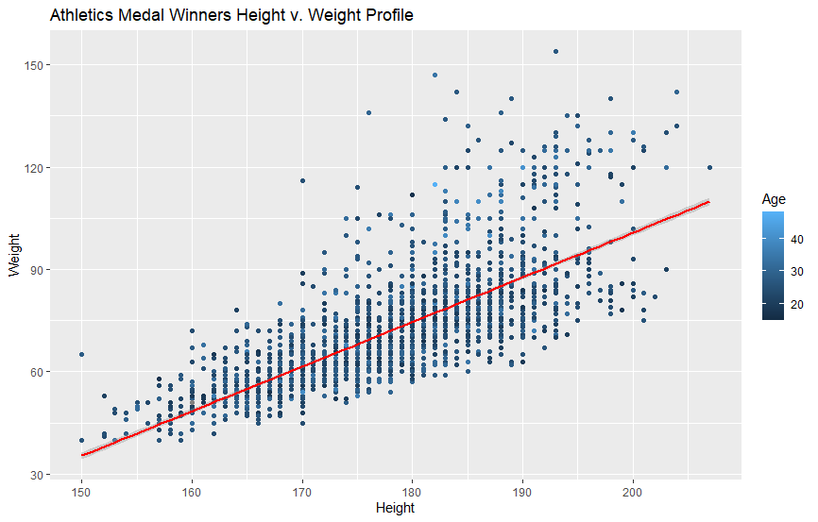
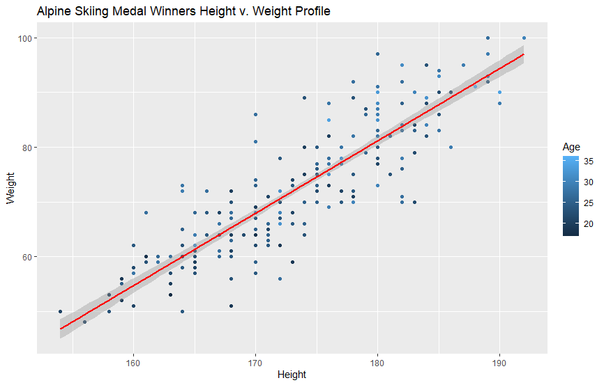
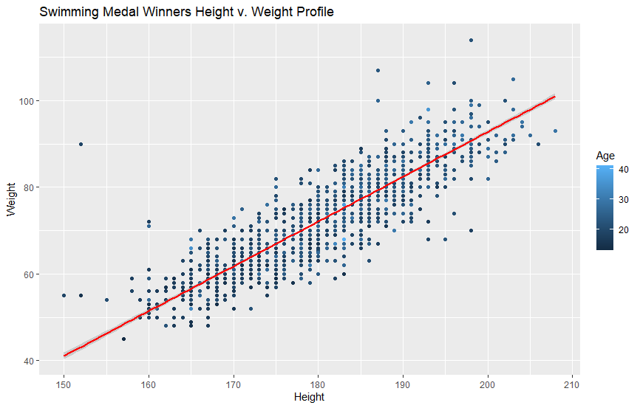
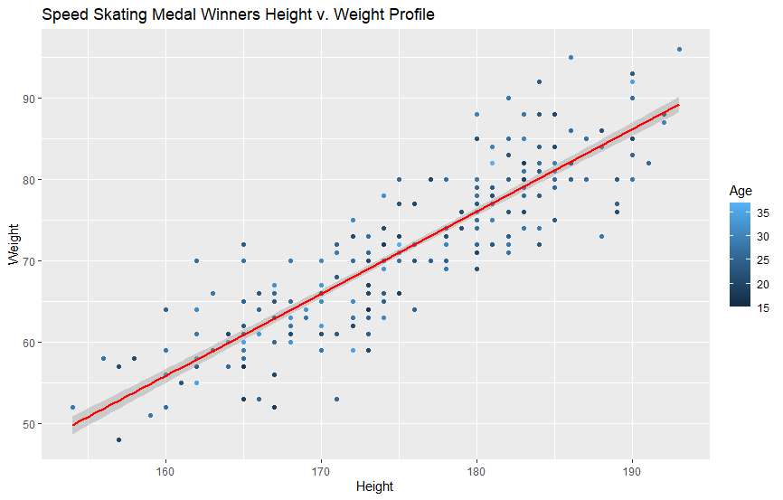
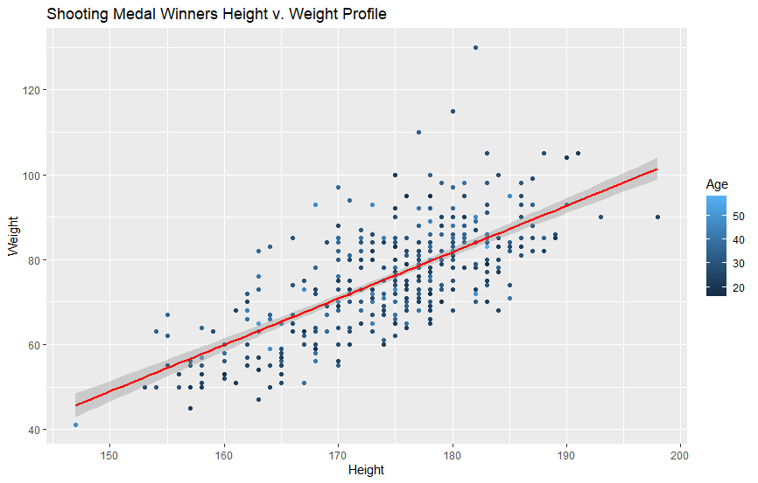
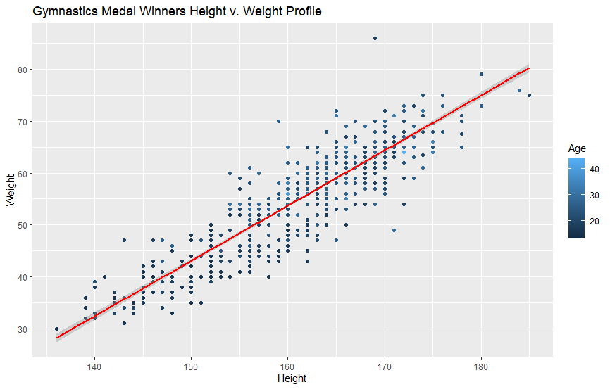
UNDERSTANDING THE DATA
Scatterplots of Athlete Profiles in Top Sports Categories – Is there a trend?

Slide 7
CHOOSING A SPORT FOR THE ATHLETES
What sport best fits their physical profile?
Fields chosen for classification:
Sex
Age
Height
Weight
Season
Team (country represented)
Classification Method:
K-Nearest Neighbors

Slide 8
CHOOSING A SPORT FOR THE ATHLETES
What sport best fits their physical profile?
Running K-Nearest Neighbors inclusive of ALL of the Sport Classifications with no filters results in a 22.75% accuracy rate.
Running K-Nearest Neighbors inclusive of ALL of the Sport Classifications with only “Sex” filtered and optimal ties results in a 30.13% accuracy rate for Females and 26.03% accuracy for Males.
LET’S NARROW OUR OPTIONS TO
SET THEM UP FOR SUCCESS!

Slide 9
PARING DOWN THE DATA
What are Jane and Bob looking for in their Olympic career?
JANE
Does not like working out in the heat – Winter games. Not into team sports, but ready to take on a healthy group of competitors!
BOB
Hates the cold – would prefer a summer sport. Likes the spotlight on him – ready for primetime!

Slide 10
PARING DOWN THE DATA
What are Jane and Bob looking for in their Olympic career?
JANE
DATA FILTERS:
Season: Winter
Eliminate: Team Sports
Athlete Count: Top Five Populous
BOB
DATA FILTERS:
Season: Summer
Eliminate: Team Sports
Sports Filter: Most popular with audiences⁽¹⁾
(1) As reported by “Ranking the Top 10 Olympic Sports to Watch” from BleacherReport.com retrieved from https://bleacherreport.com/articles/2656664-ranking-the-top-ten-olympic-sports-to-watch, citing Handball, Wrestling, Taekwondo and Judo, Table Tennis, Team Volleyball, Basketball, Water Polo, Women’s Soccer, Swimming, Track, Gymnastics

Slide 11
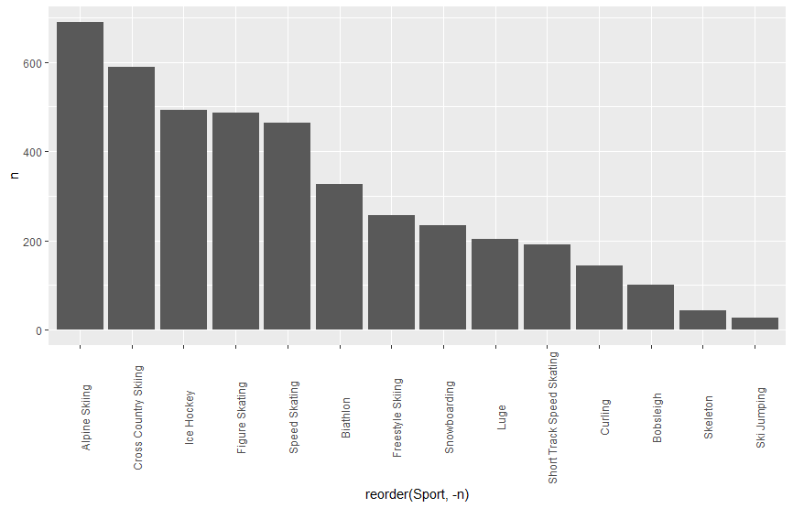
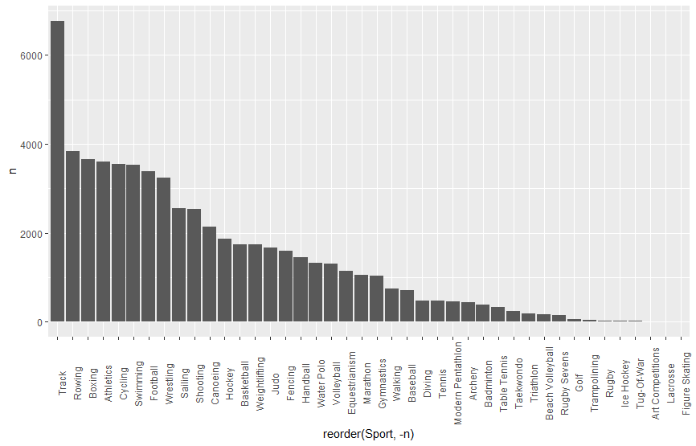
FINAL SPORTS OPTIONS
Jane Sport Filters
Bob Sport Filters

Slide 12
FINAL DECISIONS!
Based on physical stature and personal preferences, the decisions are . . .
JANE DECISION:
With a 48.83% accuracy rate, it is determined that Jane could best achieve her Olympic dream as a Figure Skater!
BOB DECISION:
With a 59.27% accuracy rate, it is determined that Bob could best achieve his Olympic dream in Swimming!

Slide 13
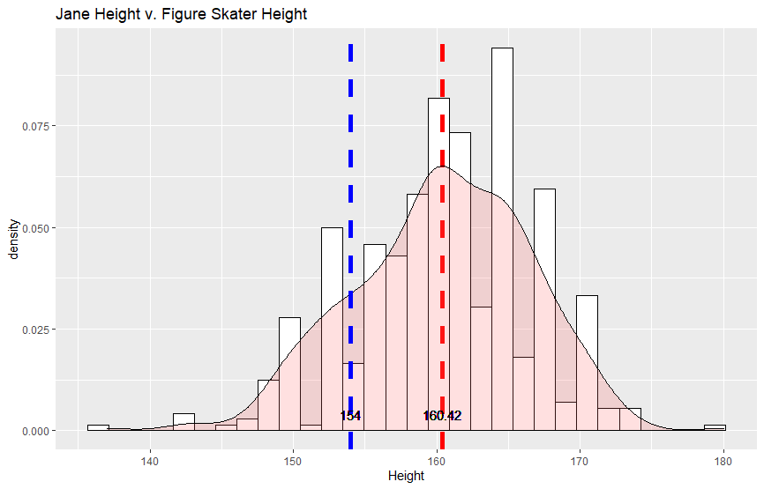
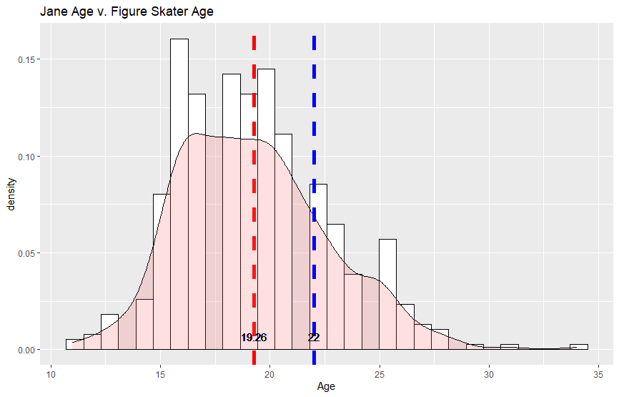
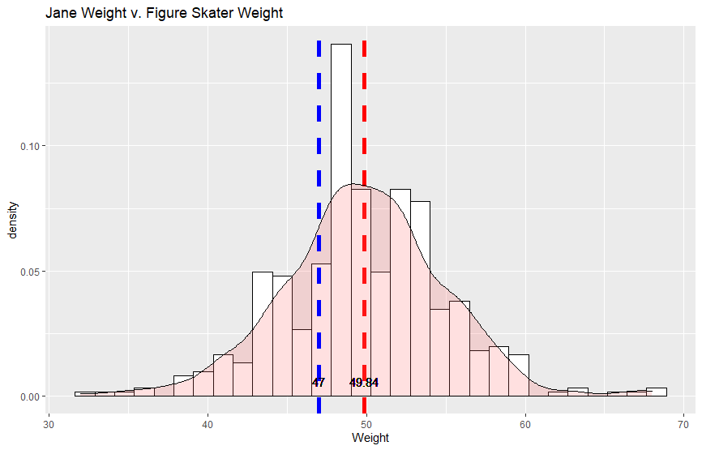
PREDICTING SUCCESS
Can Jane be successful based on physical attributes alone?
JANE
Age: 22
Height: 154 cm
Weight: 47 kg
AVERAGE
FIGURE SKATER
Age: 19.26
Height: 160.42 cm
Weight: 49.84 kg

Slide 14
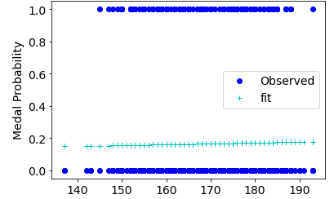
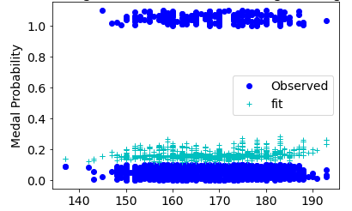
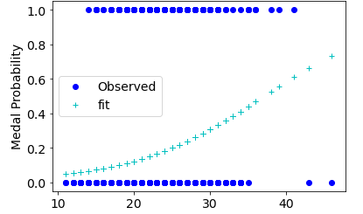
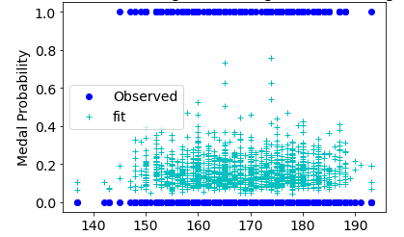
PREDICTING SUCCESS
Can Jane be successful based on physical attributes alone?
Figure Skating Medal Outcomes
Based on Height
Figure Skating Medal Outcomes
Based on Height, Weight, Sex, and representing the USA
Figure Skating Medal Outcomes
Based on Age
Figure Skating Medal Outcomes
Based on Height, Weight, and Sex

Slide 15
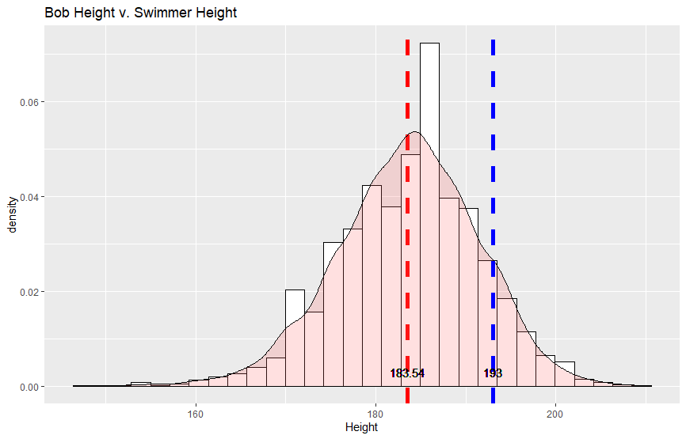
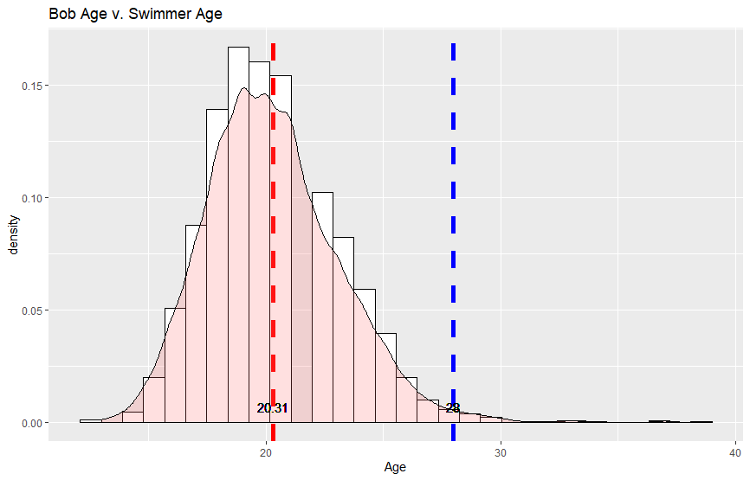
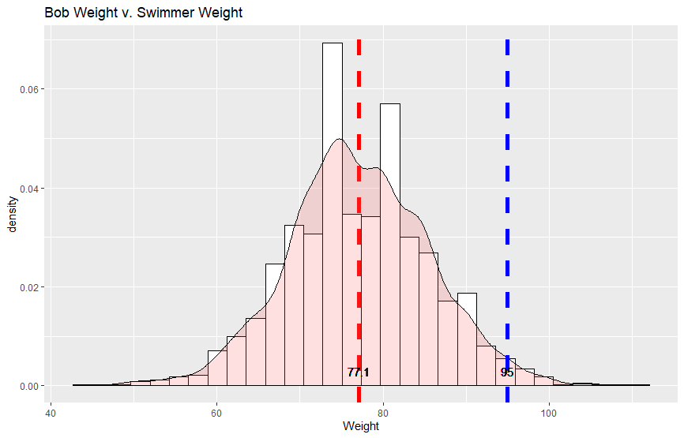
PREDICTING SUCCESS
Can Bob be successful based on physical attributes alone?
BOB
Age: 28
Height: 193 cm
Weight: 95 kg
AVERAGE
SWIMMER
Age: 20
Height: 183.54 cm
Weight: 77.10 kg

Slide 16
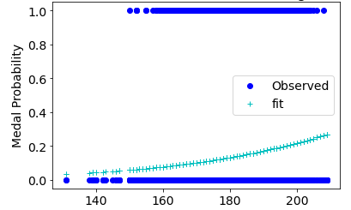
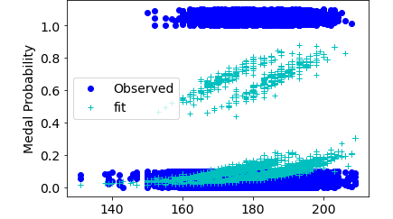
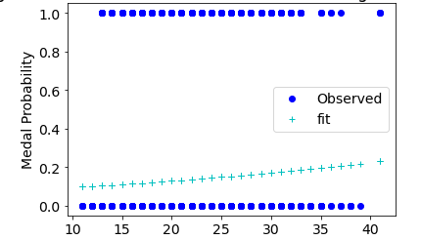
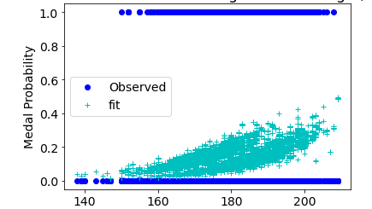
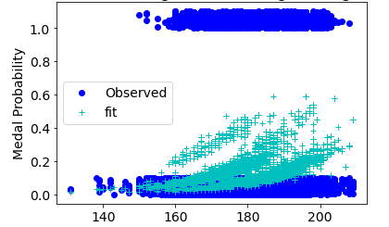
PREDICTING SUCCESS
Can Bob be successful based on physical attributes alone?
Swimming Medal Outcomes
Based on Height
Swimming Medal Outcomes
Based on Height, Weight, Sex, and representing the USA
Top Three Countries in Swimming
1. United States
2. Australia
3. Hungary
Swimming Medal Outcomes
Based on Age
Swimming Medal Outcomes
Based on Height, Weight, and Sex
Swimming Medal Outcomes
Based on Height, Weight, Sex, and representing Australia

Slide 17
EFFECTS OF SOCIAL MEDIA PRESSURE AND MENTAL HEALTH ON SUCCESS (in progress)
Retrieve Tweets from and about Several High Profile Athletes and cleaning the Tweets
Pull Tweets filtered to “Olympics” and dates after January 1, 2021, leading up to the Tokyo Olympics
Filter Olympic Tweets to the following athletes:
Simone Biles
Sunisa Lee
Caeleb Dressel – limited to no Twitter presence
Katie Ledecky
Noah Lyles
Naomi Osaka – limited to no Twitter presence
Code used from “Going for Gold: Predicting Medal Outcomes in the Olympics Using Generalized Linear Modeling” retrieved from https://towardsdatascience.com/going-for-gold-predicting-medal-outcomes-in-the-olympics-using-generalized-linear-modeling-e6e9d4837ae8

Slide 18
SOCIAL MEDIA AFFECT ON SUCCES
Does the pressure of the public and the media have an impact on an athlete?
Sentiment Analysis on Tweets
IN PROGRESS
Code used from “Use data open source python” retrieved from https://www.earthdatascience.org/courses/use-data-open-source-python/intro-to-apis/twitter-data-in-python/

Slide 19
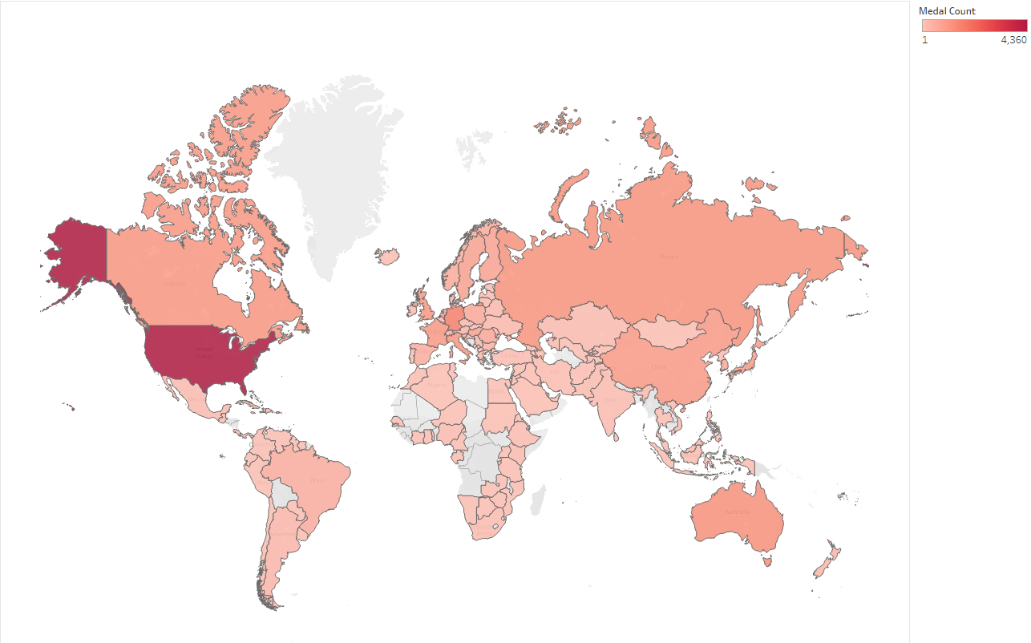
MAP & CHARTS OF MEDAL COUNTS
What other factors may contribute to the Olympic success of a country?

Slide 20
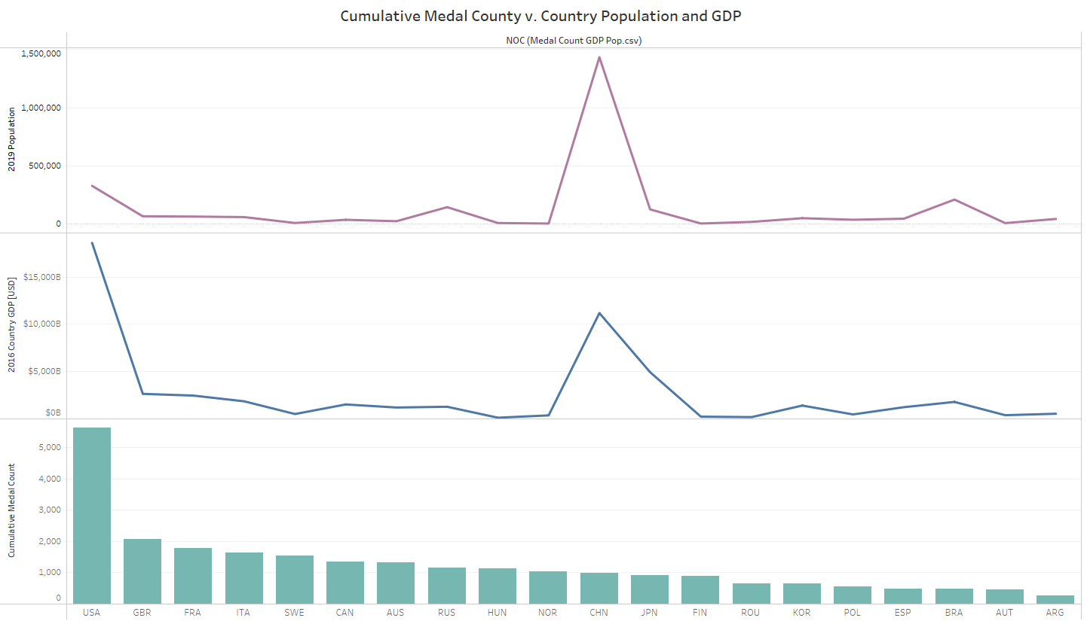
MAP & CHARTS OF MEDAL COUNTS
What other factors may contribute to the Olympic success of a country?

Slide 21
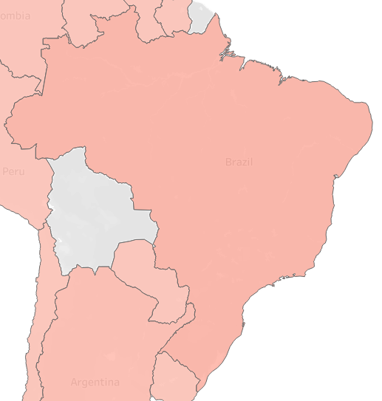
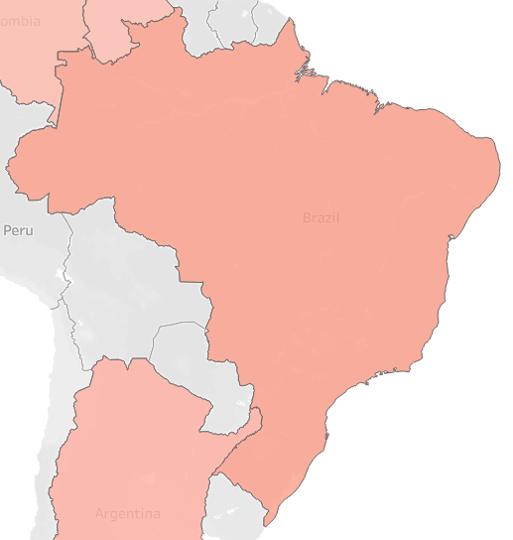
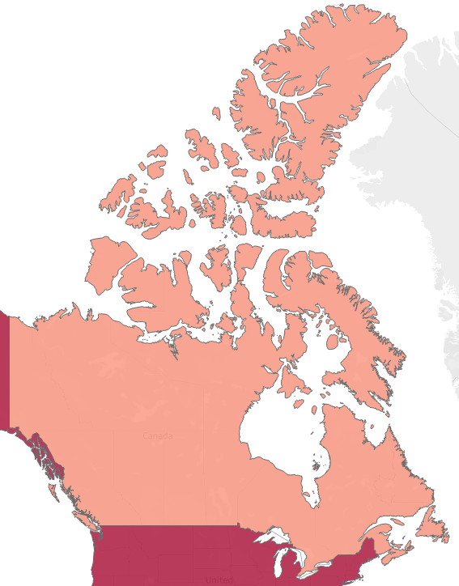
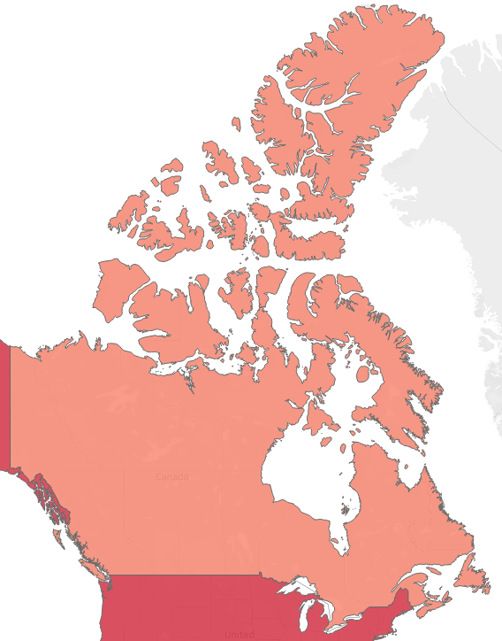
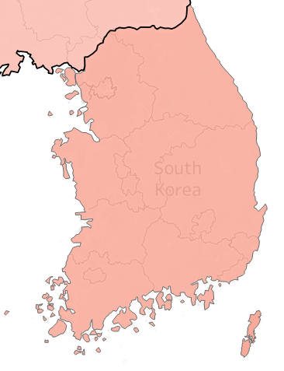
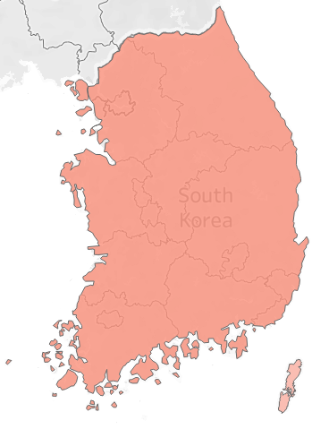
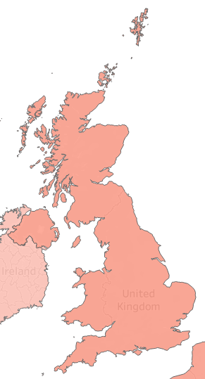
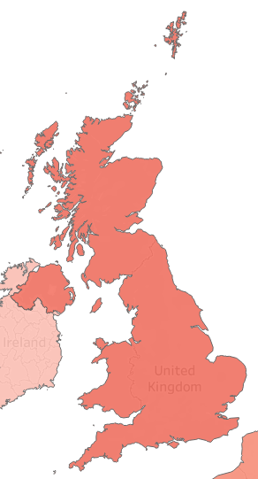
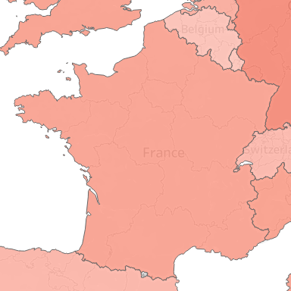
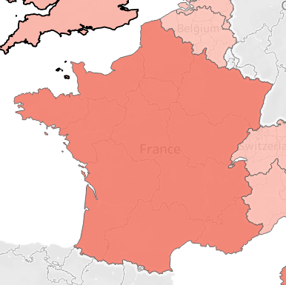
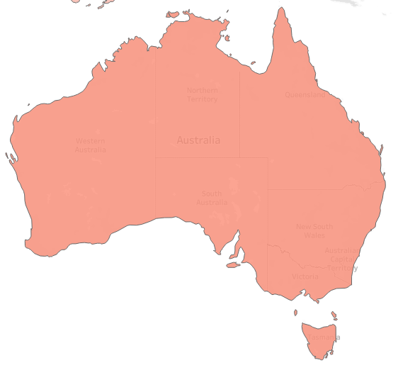
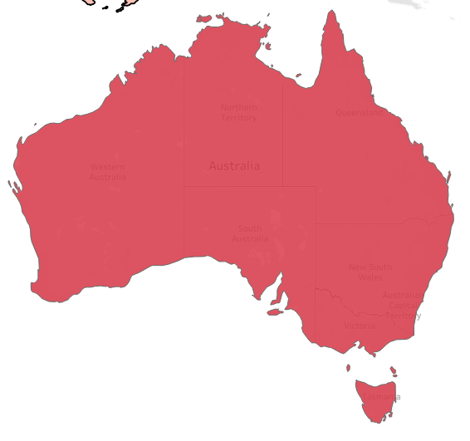
MEDAL COUNTS FOR HOST COUNTRY
Does a country have more success when it is hosting the Games?
RIO DE JANEIRO, BRAZIL
CALGARY, MONTREAL, & VANCOUVER, CANADA
SEOUL, SOUTH KOREA
LONDON, ENGLAND
PARIS, FRANCE
SYDNEY, AUSTRALIA
Medal Count
First image depicts overall medal count; second image depicts medal count while host country

Slide 22
REFERENCES
Kaggle.com. “120 years of Olympic history: athletes and results.” Retrieved on September 11, 2021 from https://www.kaggle.com/heesoo37/120-years-of-olympic-history-athletes-and-results?select=athlete_events.csv
Kaggle.com. “Population by Country – 2020.” Retrieved October 13, 2021 from https://www.kaggle.com/tanuprabhu/population-by-country-2020.
DataHub.com. “Country, Regional and World GDP (Gross Domestic Product).” Retrieved October 13, 2021 from https://datahub.io/core/gdp.
Shahir, J. 2021 August 5. Towards Data Science. “Going for Gold: Predicting Medal Outcomes in the Olympics Using Generalized Linear Modeling.” Retrieved September 11, 2021 from https://towardsdatascience.com/going-for-gold-predicting-medal-outcomes-in-the-olympics-using-generalized-linear-modeling-e6e9d4837ae8.
Pearson, C. Regis University. “Week 2 – K-nearest Neighbors (KNN).”

